Slide 1

ECE 603 Probability and Random Processes
Lessons 5-6
Chapter 3
Discrete Random Variables
Notes:
Now: Slides with Annotation
Next: Slides with Annotation
*****Preparation Notes*****
Students taking this course should already have covered linear algebra elsewhere.
We will use linear algebra extensively in this course.

Slide 2
Objectives
Explore random variables
Examine Independent Random Variables
Analyze Probability Mass Function (PMF)
Apply Special Distributions
Notes:
Now: Slides with Annotation
Next: Slides with Annotation

Slide 3
Rationale
In general, to analyze random experiments, we usually focus on some numerical aspects of the experiment.
For example, in a soccer game we may be interested in the number of goals, shots, shots on goal, corners kicks, fouls, etc.
In a nutshell, a random variable is a real-valued variable whose value is determined by an underlying random experiment.
Notes:
Now: Slides with Annotation
Next: Slides with Annotation

Slide 4
Prior Learning
Basic Concepts
Counting Methods
Access to the online textbook: https://www.probabilitycourse.com/
Notes:
Now: Slides with Annotation
Next: Slides with Annotation

Slide 5

Random Variables
Random experiments have sometimes numerical outputs, such as
Lifetime of a certain product:
Amount of money a gambler wins on a trip to the casino
etc.
Even if the event is not numerical, it can often be considered in terms of numbers (for convenience and mathematical analysis).

Slide 6
Random Variables
Example. Toss a coin five times. Observe the number of heads:
We define a random variable that gets its value from the outcome of the random experiment:
Definition: A random variable is a real-valued variable that gets its value from a random experiment.

Slide 7


Random Variables
Formal Definition: A random variable is a real-valued function on the sample space:
Definition: Range of is the set of possible values for .
In the above example,
We show random variables with capital letters .

Slide 8

Random Variables
Example. Flip a coin twice, the number of heads
Example. T: Lifetime of a certain product:

Slide 9


Random Variables
Countable set:
Finite set
One-to-one correspondence with Natural Numbers
i.e.,
i.e., I can “list” the elements.

Slide 10
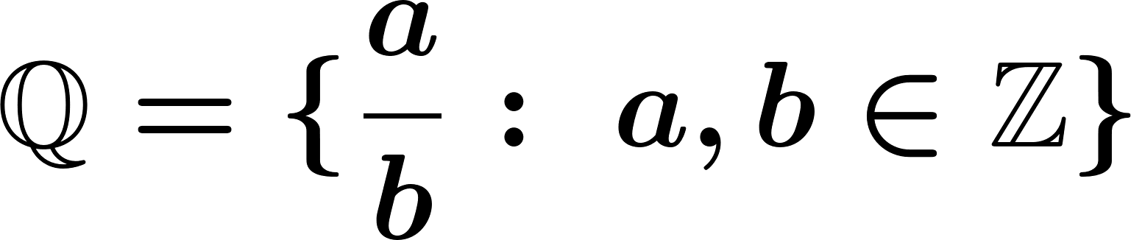
Random Variables
Countably infinite sets:
List:
Countable

Slide 11

Random Variables
However is Not countable, in fact
is Not countable.

Slide 12
Discrete Random Variables
Definition: is a discrete random variable, if its range is countable.
We show the values in the range by lower case letters.

Slide 13
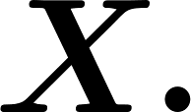
Probability Mass Function
Definition: is a discrete random variable,
The function:
is called the probability mass function (PMF) of

Slide 14
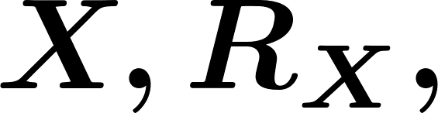
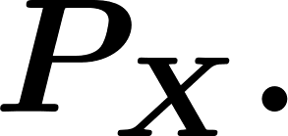
Probability Mass Function
Example 1. Toss a fair coin twice, # of heads.
Find the range of as well as its probability mass function

Slide 15
Probability Mass Function
Example 2: # of rolls of a die until the first 6 appears.
Find the range of as well as its probability mass function

Slide 16
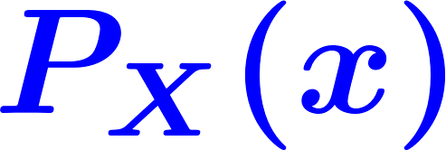
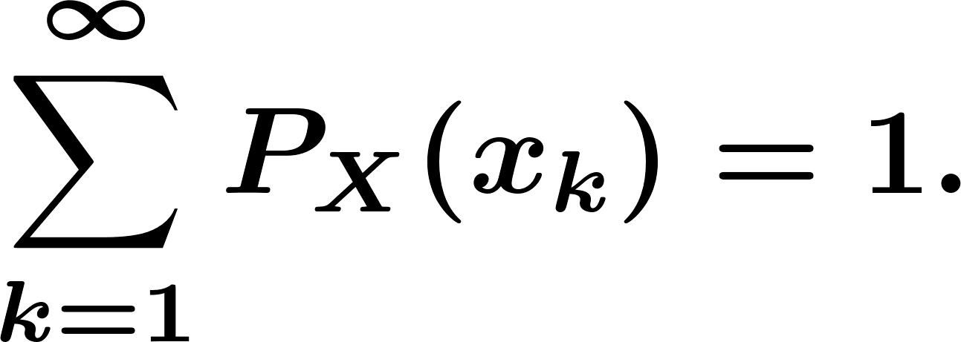
Probability Mass Function
Thm. For a discrete random variable with PMF and Range

Slide 17
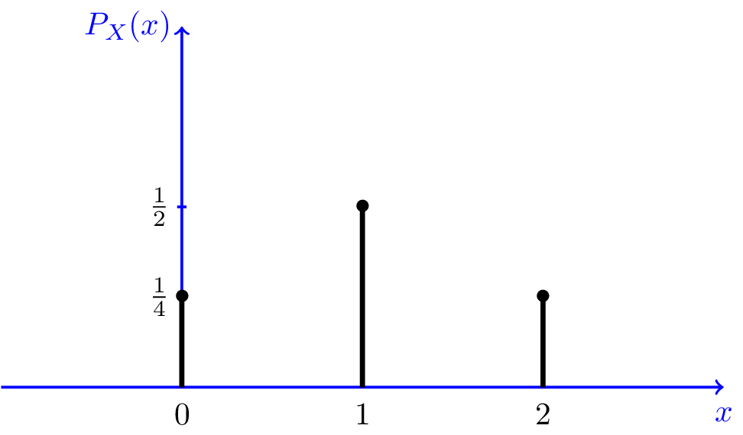
Probability Mass Function
If we repeat the experiment over and over and plot the histogram, it will look like
The PMF in example 1

Slide 18

Independent Random Variables
Definition: Consider two discrete random variables and . We say that and are independent if
In general, if two random variables are independent, then you can write

Slide 19

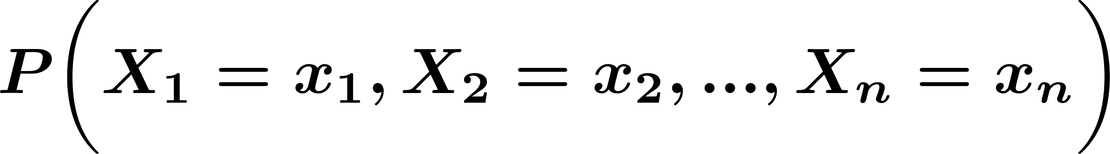
Independent Random Variables
Definition: Consider discrete random variables We say that are independent if

Slide 20

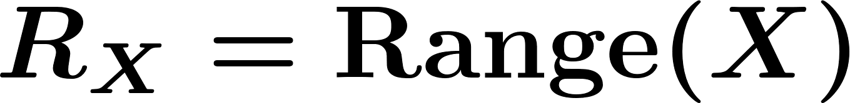
Summary of Random Variables
Random Variables
Discrete Random Variable is countable, i.e.,
PMF:
Independent Random Variable

Slide 21
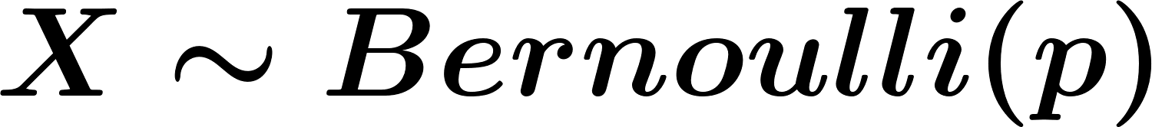
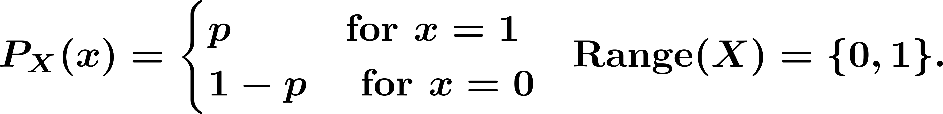
Special Distributions
Families of discrete random variable
Bernoulli RVs:
Example. Flip a coin {H,T}. Take an exam {Pass, Fail}.
PMF:

Slide 22
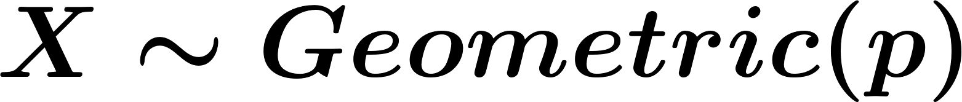
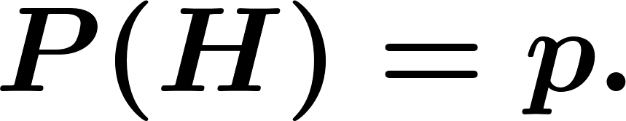
Special Distributions
Geometric RVs:
Random experiment: consider a coin with Toss the coin repeatedly until the first heads is observed.
The total number of coin tosses

Slide 23

Special Distributions
Definition. A random variable is said to be a geometric random variable with parameter , shown as , if

Slide 24
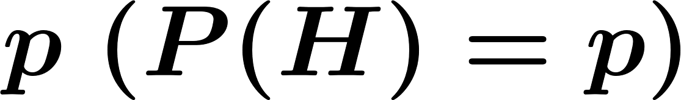
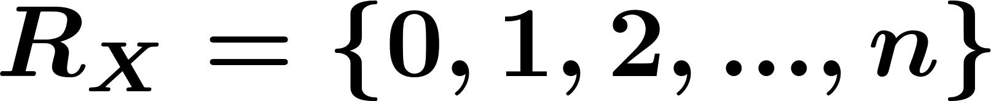
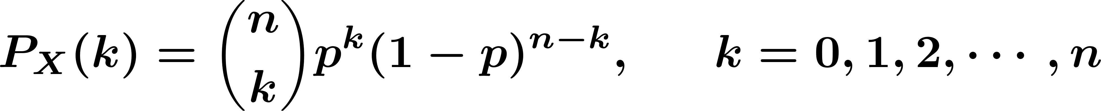
Special Distributions
Definition. A random variable is said to be a binomial random variable with parameters and , shown as , if

Slide 25

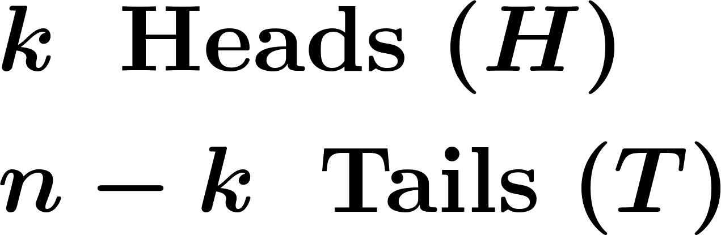
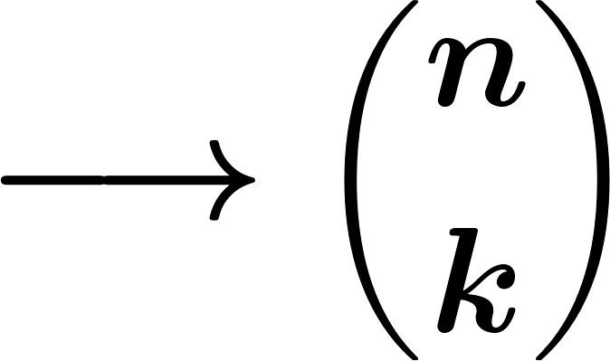

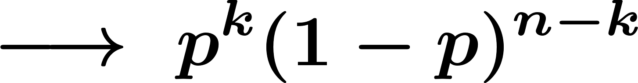

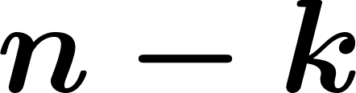
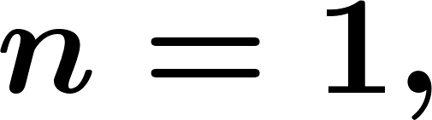
Special Distributions
Remember:
HTH . . . H
HH . . . HTT . . . T
If then
times
Heads
Tails

Slide 26
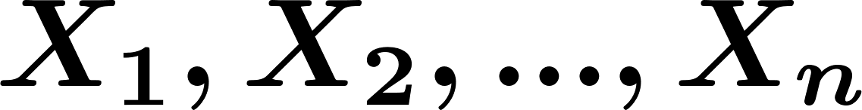
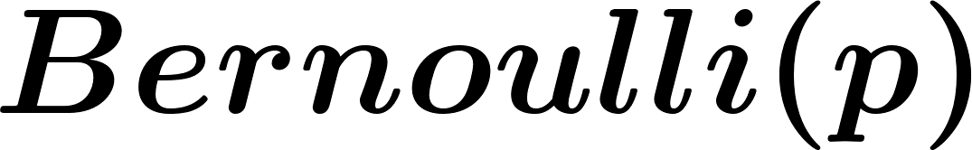
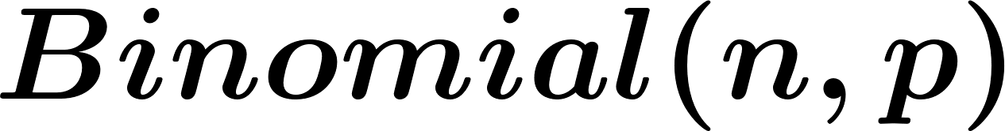
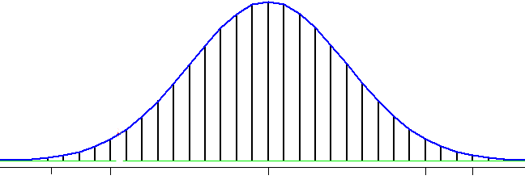

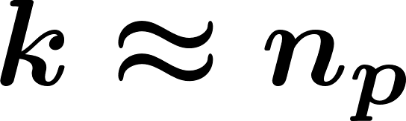
Special Distributions
Lemma. If are independent random variable, then the random variable define by is a RV.
distribution.

Slide 27






Special Distributions
Pascal Distribution (Negative Binomial):
Example. You flip a coin until you observe heads.
total number of coin toss
Find PMF.
is the event that we observe heads in the first trials.
is the event that we observe a heads in the kth (the last) trial.

Slide 28
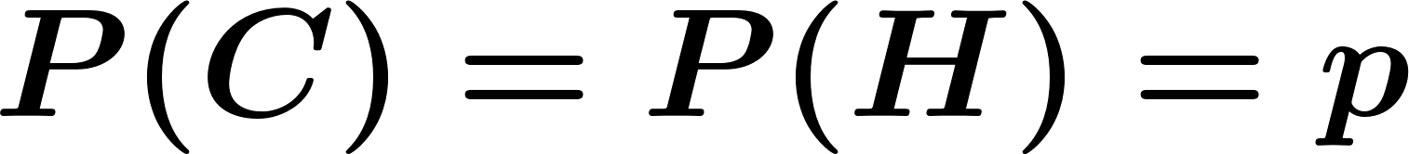
Special Distributions
Using binomial formula,

Slide 29
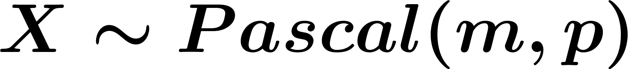

Special Distributions
Definition. A random variable is said to be a Pascal random variable with parameters and , shown as , if
Where

Slide 30


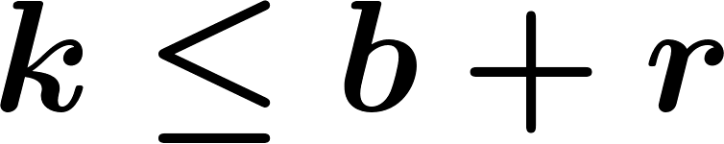
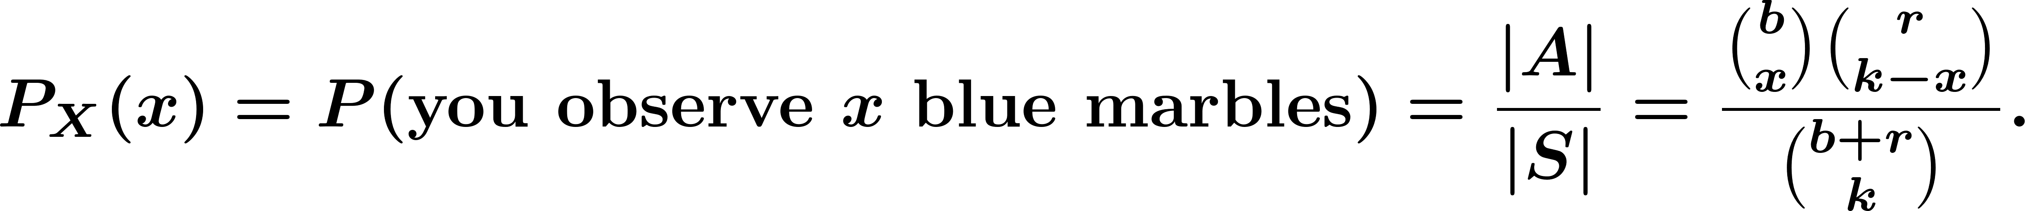
Special Distributions
Hypergeometric Distribution:
Example. You have a bag that contains blue marbles and red marbles. You choose marbles at random (without replacement).
The number of blue marbles in your sample

Slide 31
Special Distributions
Poisson Random Variable:
Poisson RVs are used to model
Arrival of customers at a service facility
Arrival of information request at a server
Counting the occurrence of certain events in an interval of time or space.

Slide 32



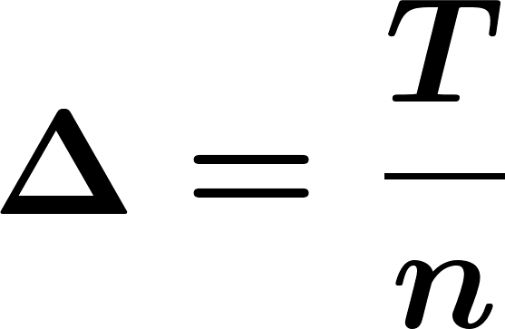

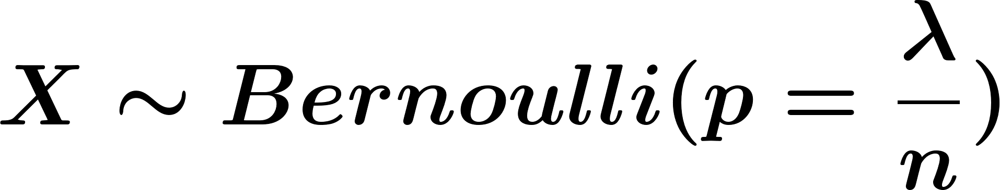
Special Distributions
Arrival of customers in an interval:
the average number of arrivals in that interval

Slide 33
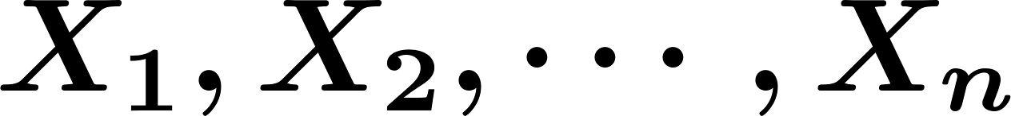
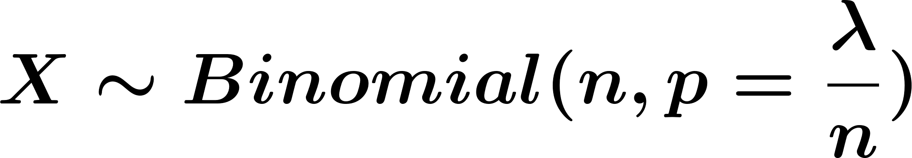
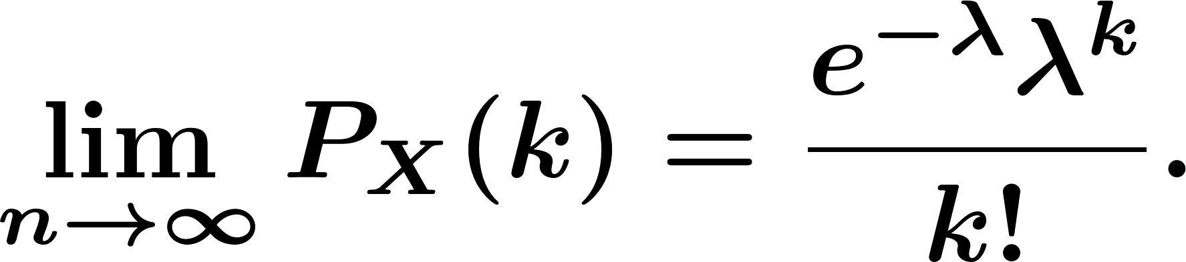
Special Distributions
the total number of customers =
Thus,

Slide 34
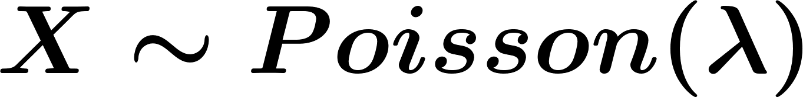
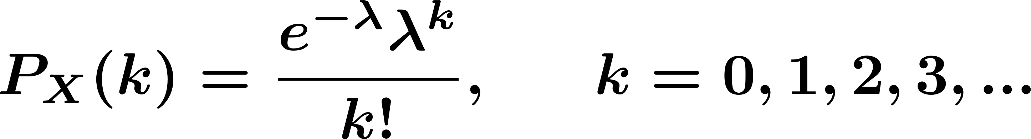
Special Distributions
Definition. A random variable is said to be a Poisson random variable with parameter , shown as , if

Slide 35
Orchestrated Conversation: Special Distributions
Example. The number of hits to a website is a Poisson with average 2 hits per second.
What is the probability of no hits in 0.25 seconds?
What is the probability of no more than 2 hits in 1 second?

Slide 36
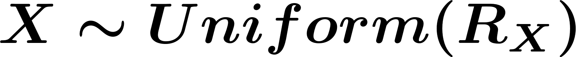
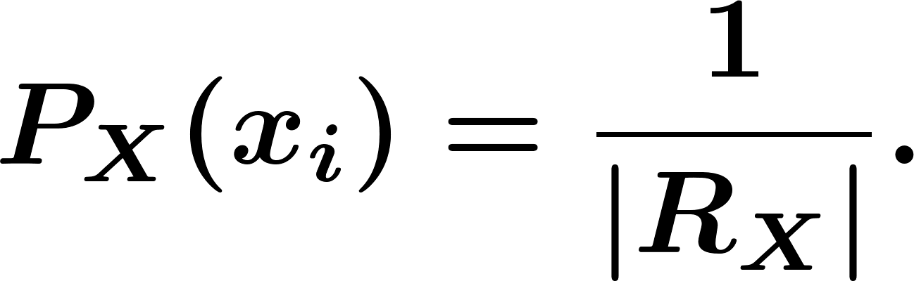
Special Distributions
Definition. A random variable is said to be a Uniform random variable, shown as , if

Slide 37
Orchestrated Conversation: Cumulative Distribution Function (CDF)
Definition. Let be any random variable, the function
is called the CDF of .
Example. In a family with three children, is the number of daughters. Find CDF.

Slide 38
Orchestrated Conversation: Cumulative Distribution Function (CDF)
Definition. The cumulative distribution function (CDF) of random variable is defined as
Example. Toss a coin twice, let be the number of observed heads. Find the CDF of .

Slide 39
Cumulative Distribution Function (CDF)
Example. Toss a coin twice, let be the number of observed heads. Find the CDF of .

Slide 40
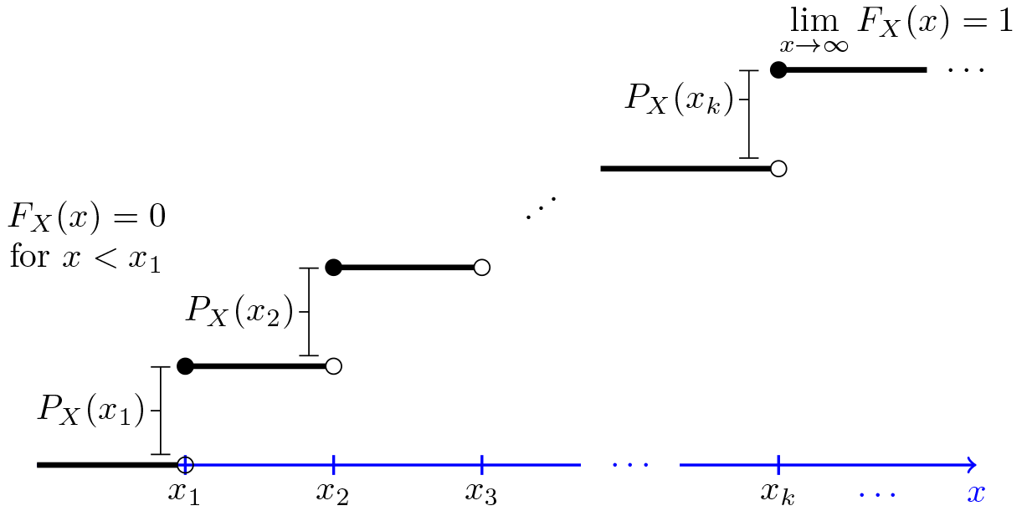
Cumulative Distribution Function (CDF)
If is a discrete random variable with range such that

Slide 41
Cumulative Distribution Function (CDF)
Theorem. Let be a discrete random variable with range

Slide 42
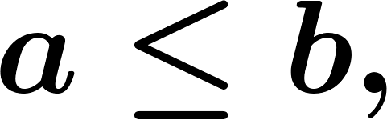
Cumulative Distribution Function (CDF)
For all we have

Slide 43
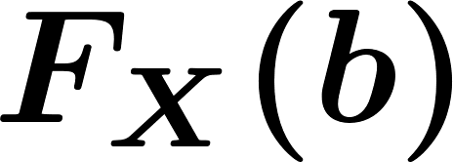
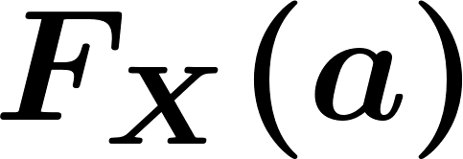
Cumulative Distribution Function (CDF)
Proof:

Slide 44
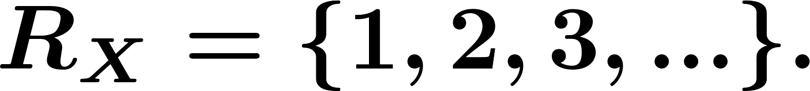
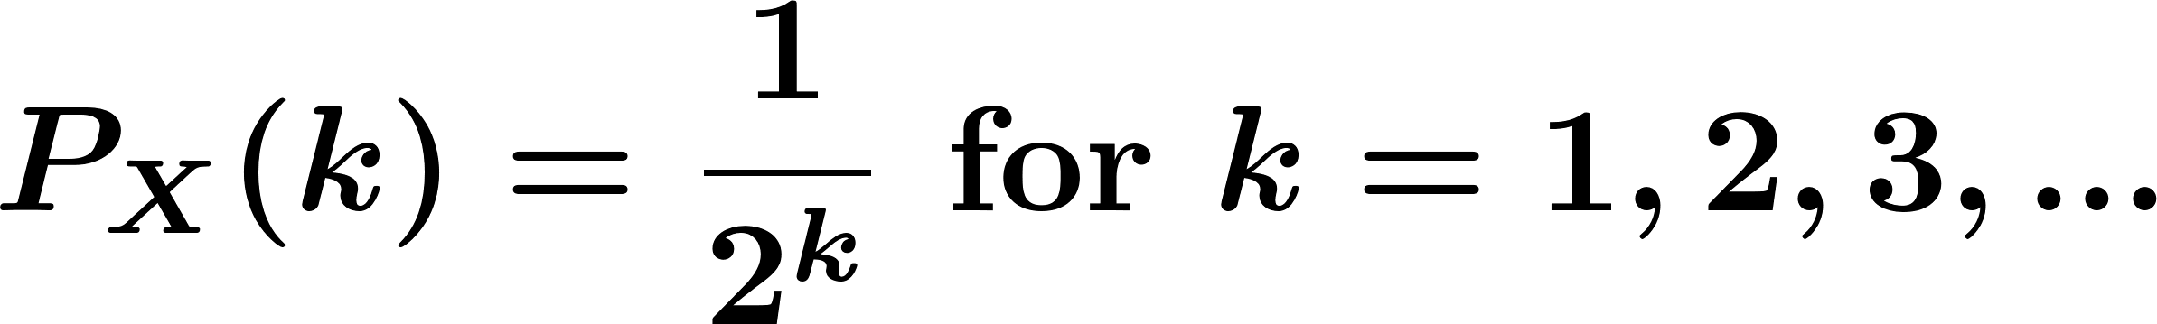
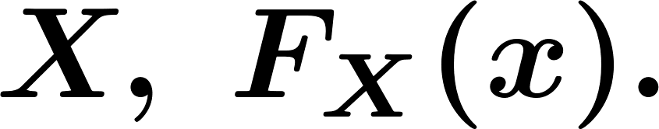
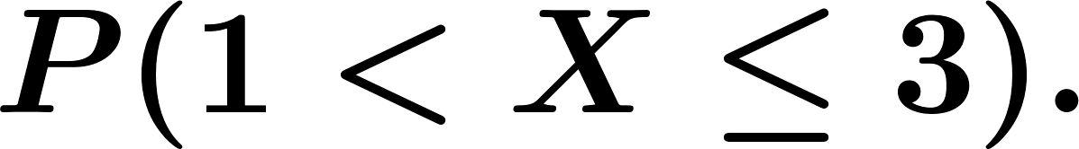
Cumulative Distribution Function (CDF)
Example. Let be a discrete random variable with range Suppose the PMF of is given by
Find and plot the CDF of
Find

Slide 45
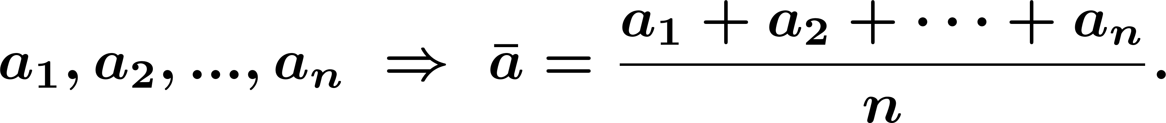
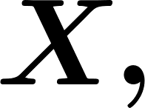

Expectation
Expected value (= mean=average):
Definition. Let be a discrete random variable with range The expected value of denoted by is defined as

Slide 46

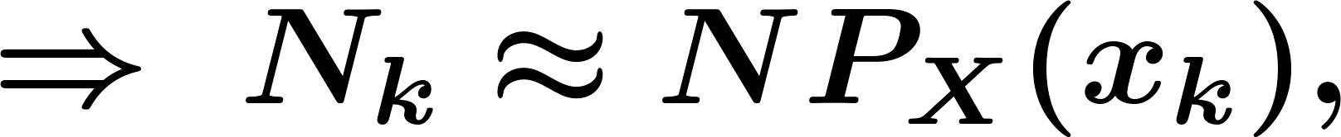

Expectation
Repeat the experiment times ( large).

Slide 47


Expectation
Example. Let find

Slide 48

Expectation
Example. Let find

Slide 49

Expectation
Example. Let find

Slide 50

Summary
Discrete RVs:
Range:
PMF:
CDF:
Excepted value:

Slide 51

Summary

Slide 52


Functions of Random Variables
If is a random variable and , then itself is a random variable.
For example:
Then,

Slide 53




Functions of Random Variables
Example. Let be a discrete random variable uniformly distributed with
for Let
Find PMF of
Find

Slide 54



Functions of Random Variables
Law of the unconscious statistician (LOTUS) for discrete random variables:
In the previous example

Slide 55



Functions of Random Variables
Linearity of expectation:
Proof: Here so using LOTUS we have

Slide 56
Functions of Random Variables
More generally (Linearity of expectation):
Example.

Slide 57


Functions of Random Variables
Example. Let , such that
Find

Slide 58

Variance
The variance is a measure of how spread out the distribution of a random variable is.
The variance of a random variable , with mean , is defined as

Slide 59
Variance
The standard deviation of a random variable is defined as

Slide 60


Variance
Theorem. Computational formula for the variance:
Proof:

Slide 61
Variance
Example.

Slide 62


Variance
Theorem. For a random variable and real numbers and ,
Proof:
If . Thus,

Slide 63
Variance
Theorem. If are independent random variables and
, then

Slide 64
Variance
Example.

Slide 65
Post-work for Lessons 5-6
Complete homework assignment for Lessons 5-6: HW#3
Go to the online classroom for details.
Notes:
Now: Slides with Annotation
Next: Slides with Annotation

Slide 66
To Prepare for the Next Lesson
Read Chapter 4 in your online textbook:
https://www.probabilitycourse.com/chapter4/4_0_0_intro.php
Complete the Pre-work for Lessons 7-9.
Visit the online classroom for details.
Notes:
Now: Slides with Annotation

